Slide 1



AIR AWARE
Smart Air Quality Prediction System
Team Members
K. Likitha
S.Sneha
Sahil
Raunit Singh
Faariha

Slide 2

PROBLEM STATEMENT
Air pollution levels are increasing rapidly.
People are unaware of current AQI and health impacts.
Existing platforms are complex and not user-friendly.
PROPOSED SOLUTION
AirAware provides a simple, clean web dashboard
Shows real-time AQI values
Uses Machine Learning for AQI prediction
Offers health advice and reports
01

Slide 3
FEATURES
  Clean & user-friendly UI
  Real-time AQI values
  Machine Learning based AQI prediction
  AI-powered Chatbot (Air Quality Assistant)
  Health advisory suggestions
  Downloadable AQI reports (PDF)
  Dark & Light mode toggle
  User feedback system
  Responsive dashboard for all devices
03

Slide 4
FRONTEND OVERVIEW
  Frontend Technologies
  HTML5
  CSS3
  JavaScript
  Google Material Icons
  Chart.js (for graphs & visualizations)
  Purpose:
  Design clean UI
  Display AQI cards, charts & dashboard
  Improve user experience
04

Slide 5

BACKEND WORK
Backend Technologies
  Python
  Flask Framework
Backend Responsibilities
  Handle API requests
  Connect frontend with ML model
  Fetch real-time pollution data
  Generate AQI predictions
  Provide JSON responses to UI
05

Slide 6
DATABASE & MACHINE LEARNING
Database
  MySQL
  Stores:
    User login details
    Feedback data
    AQI records
Machine Learning
  Linear Regression model
  Used for AQI prediction
  Trained on historical AQI dataset
  Inputs: PM2.5, CO, NO₂
  Output: AQI value
06

Slide 7
SYSTEM ARCHITECTURE
Workflow
  User interacts with frontend dashboard
  Request sent to Flask backend
  Backend fetches real-time pollution data
  ML model predicts AQI
  Data sent back as JSON
  Charts & AQI cards update dynamically
  Reports can be downloaded as PDF
06

Slide 8
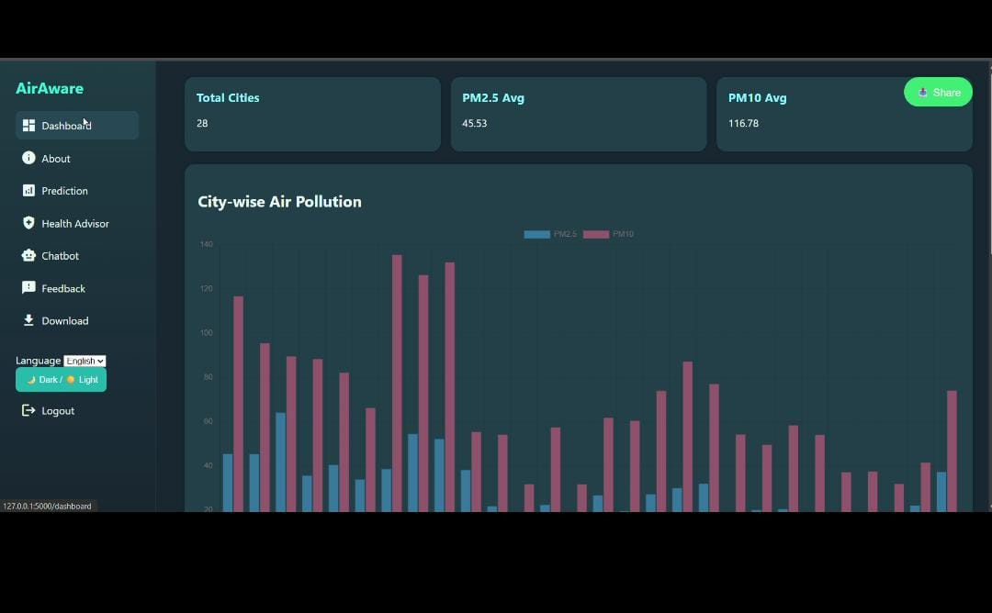
07

Slide 9
TEAM CONTRIBUTIONS
Team Member Contributions
  Sahil & Faariha:
    Complete backend development
    API handling & ML integration
  Likitha:
    Frontend UI design
    Dashboard layout & responsiveness
  Raunath Singh:
    MySQL database queries
    Basic ML model preparation
  Sneha:
    AI Chatbot integration
    Chatbot logic using GPT-4o mini
09

Slide 10
EXTRA FEATURES
  Session-based login system
  Dark / Light theme toggle
  Multi-language support (i18n using Flask session)
  CSV file import/export
  Download:
  All AQI data
  City-wise AQI data
  AI Chatbot using GPT-4o mini
  Fully responsive dashboard UI
09

Slide 11
CONCLUSION
  AirAware provides a smart and reliable AQI monitoring system
  Combines UI, ML, real-time data & AI chatbot
  Helps users understand air pollution easily
  Improves public awareness and health safety
09

Slide 12
THANK YOU
10

